Slide 1


Slide 2


Slide 4


Slide 5


Slide 6


Slide 7


Slide 8


Slide 9
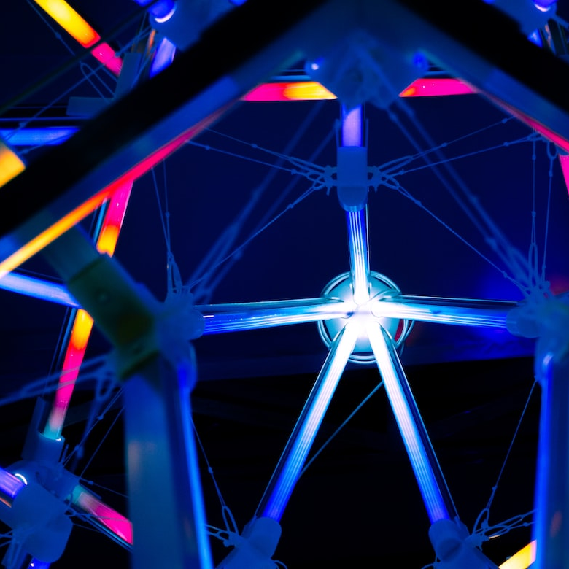

Slide 10


Slide 11


Slide 12


Slide 13
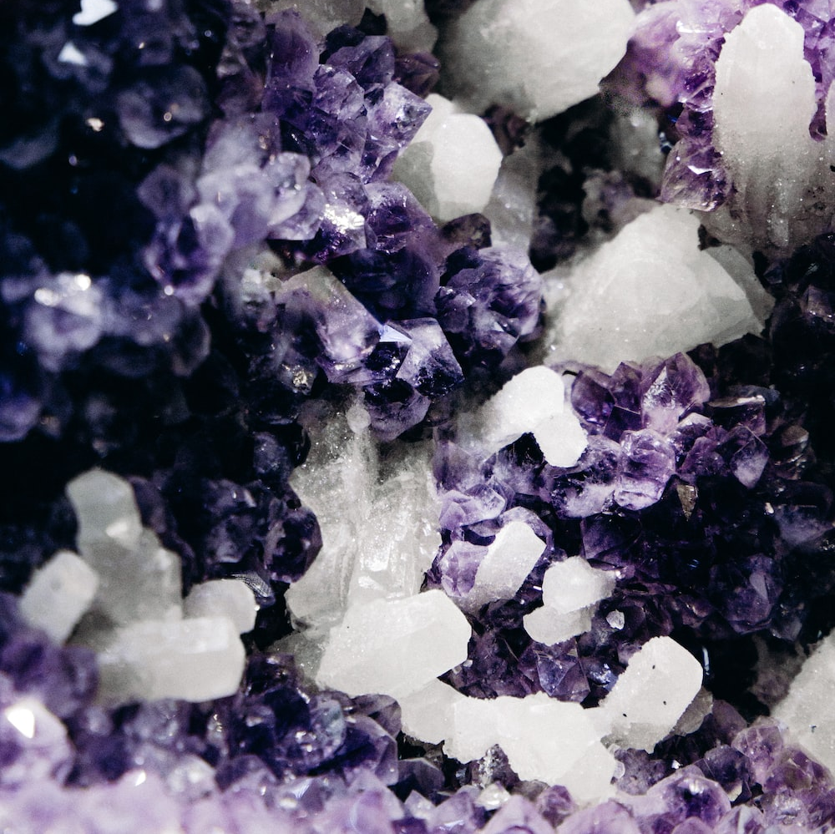

Slide 14


Slide 15
Home
About
CV
Research
PopSci
Blog
Contact

Slide 16
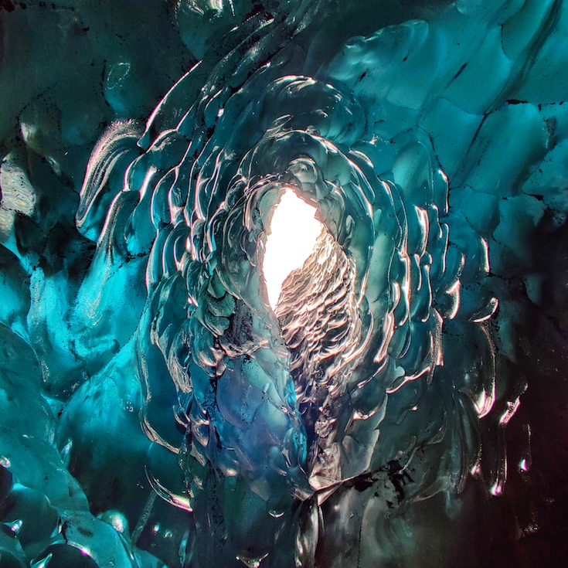

Slide 18


Slide 20
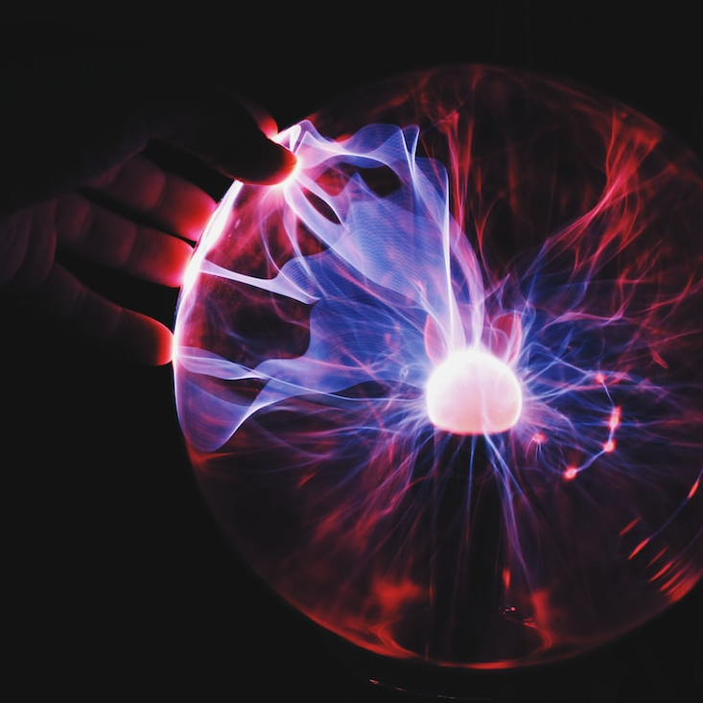

Slide 22


Slide 23



Slide 24



Slide 25





Slide 26


Slide 27

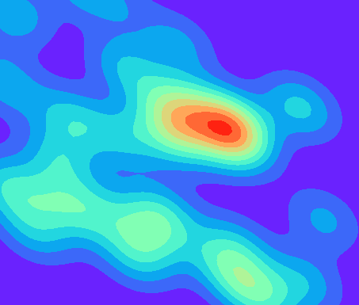

Discovery
Exploration
Interpretation

